Slide 1
Legislation and Conservation

Slide 2
Legislation and Conservation: Legal framework for conservation
The Protection and Conservation of Fish Act, 1950
The Protection and Conservation of Fish (Amendment) Ordinance, 1982
The Protection and Conservation of Fish (Amendment) Act,1995
The Protection and Conservation of Fish Rules, 1985
Tanks Improvement Act, 1939
Bangladesh Fisheries Development Corporation Act, 1973

Slide 3
Legal framework for conservation
Marine Fisheries Ordinance, 1983
Marine Fisheries Rules, 1983
Marine Fisheries Rules, 2023
Marine Fisheries Act, 2020
The Territorial Waters and Maritime Zones Act, 1974
The Territorial Waters and Maritime Zones Rules, 1977
National Fisheries Policy, 1998

Slide 4
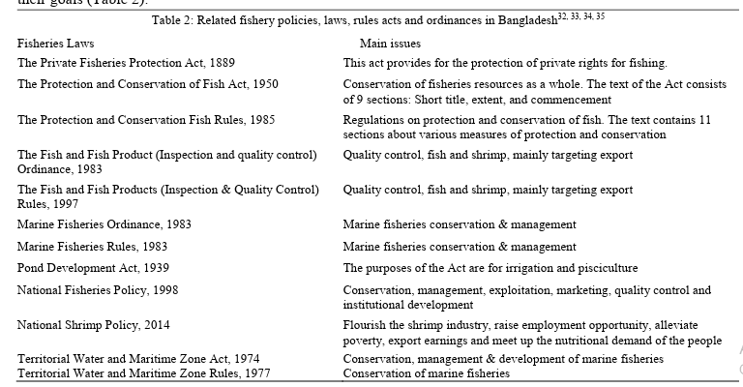
Legal framework for conservation

Slide 5
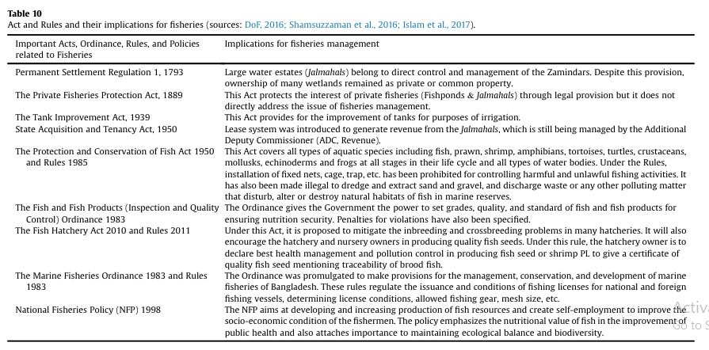
Legal framework for conservation

Slide 6
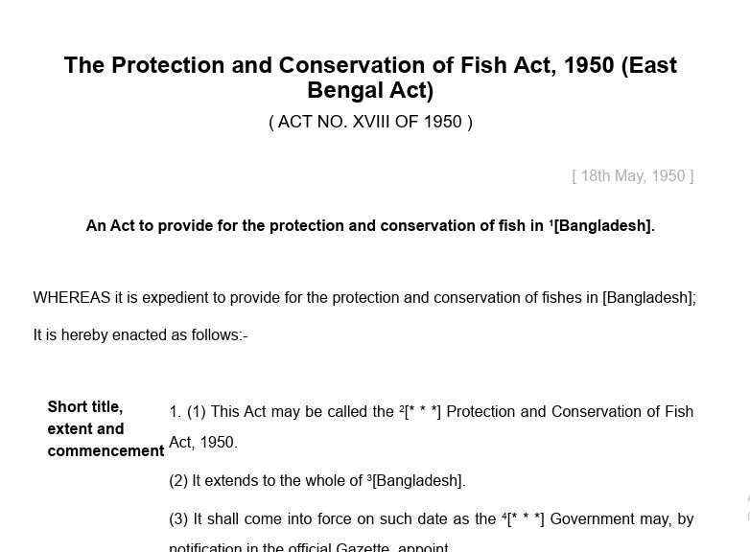

Slide 7
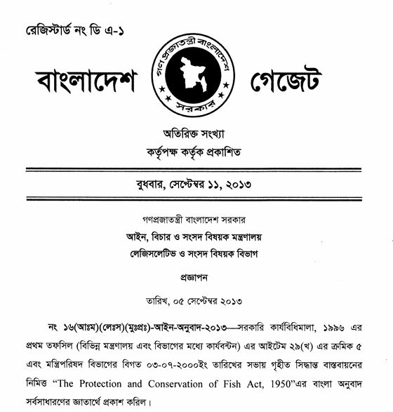

Slide 8
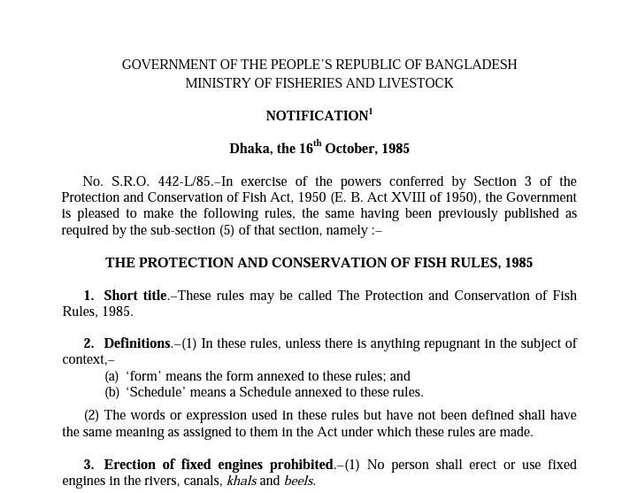

Slide 9


Slide 10
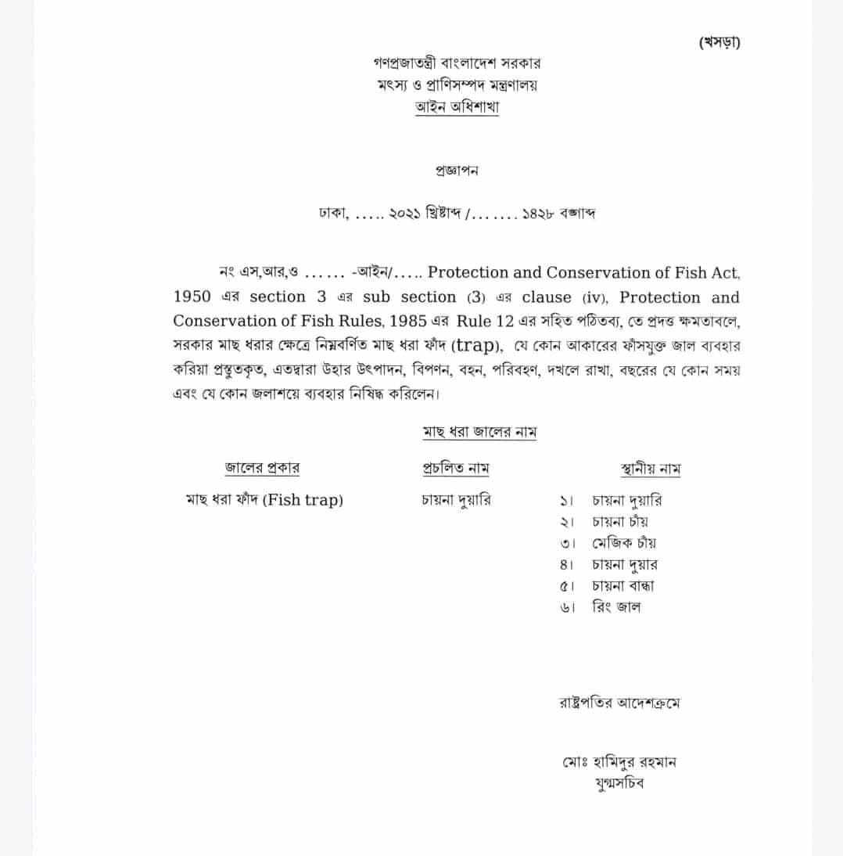

Slide 11
